Slide 1
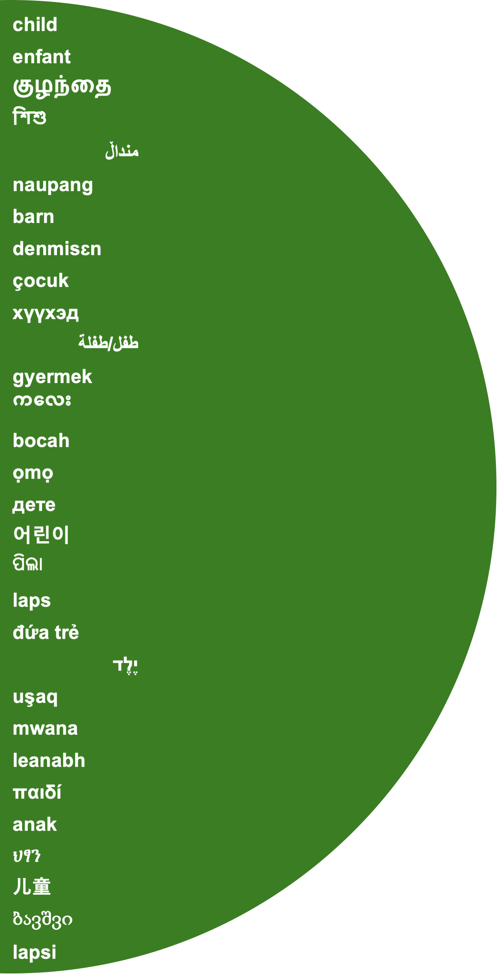
Images of the Child
Methodological Options for
Extracting Cultural Models from Text
Chris Borst
Sociology, McGill
CSA 2025

Slide 2
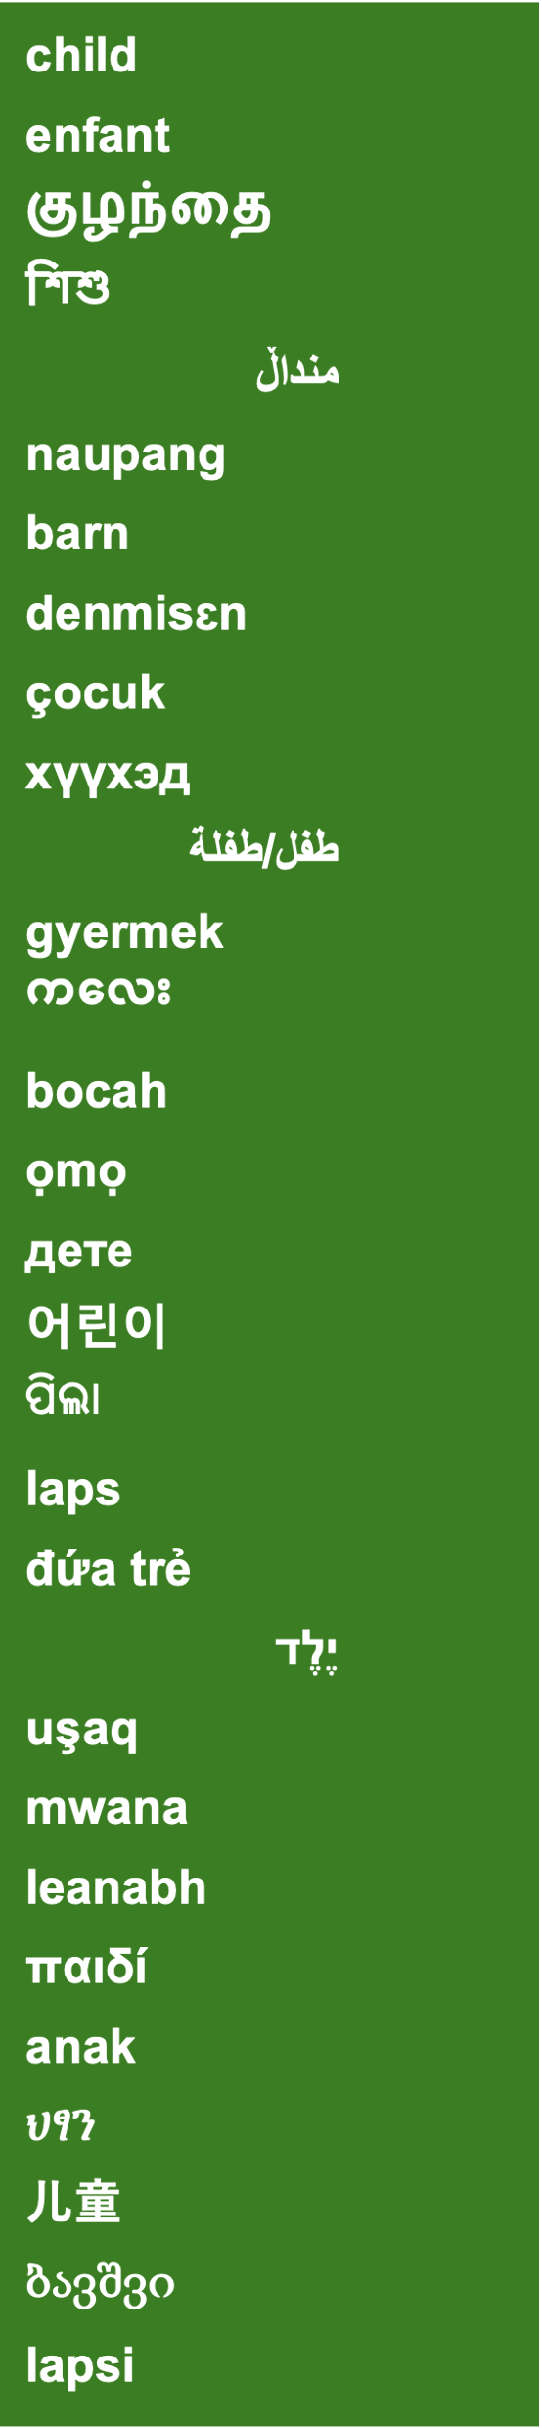
Images of the child: Prevailing approaches
One image approach
Two image approaches
Three image approaches
Innocence
Dependency
Human Capital
Democratic, experimental
Individualist
Libertarian
Human capital, child development
Collectivist
Authoritarian
Apollonian/Cherubs
(Rousseau)
v.
Athenian/Chattel
(Locke)
v.
Dionysian/Changelings
(Wesley)
v.
v.
v.
but …
“There are hundreds of different images of the child.”
- Loris Malaguzzi (1994)

Slide 3
A general method
Inputs (survey, text, etc.)
Dimension reduction
Clustering

Slide 4
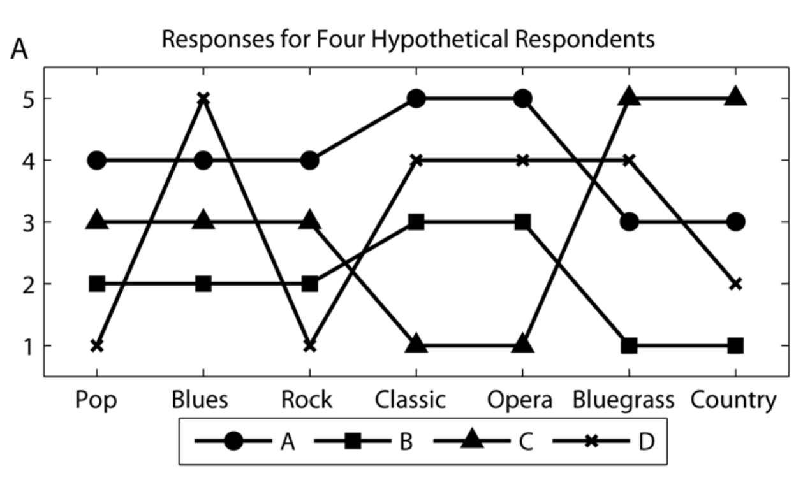
Cultural cartography Relational Class Analysis

Slide 5
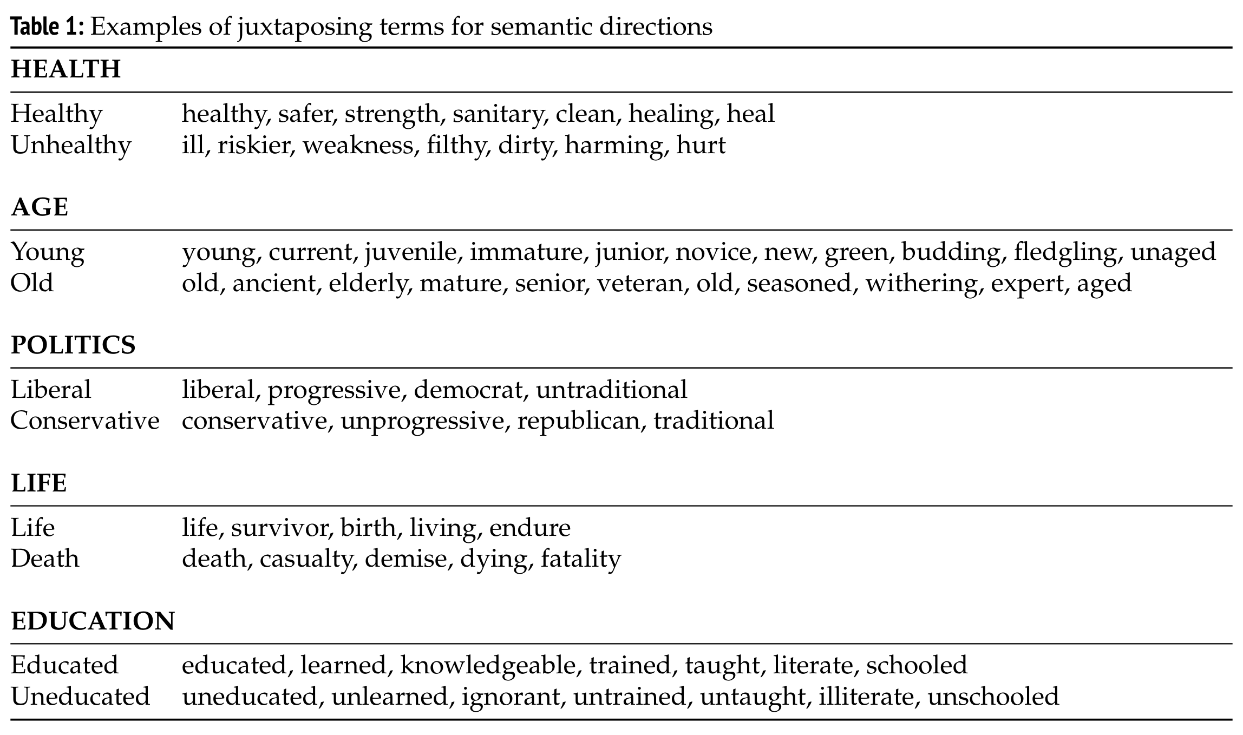
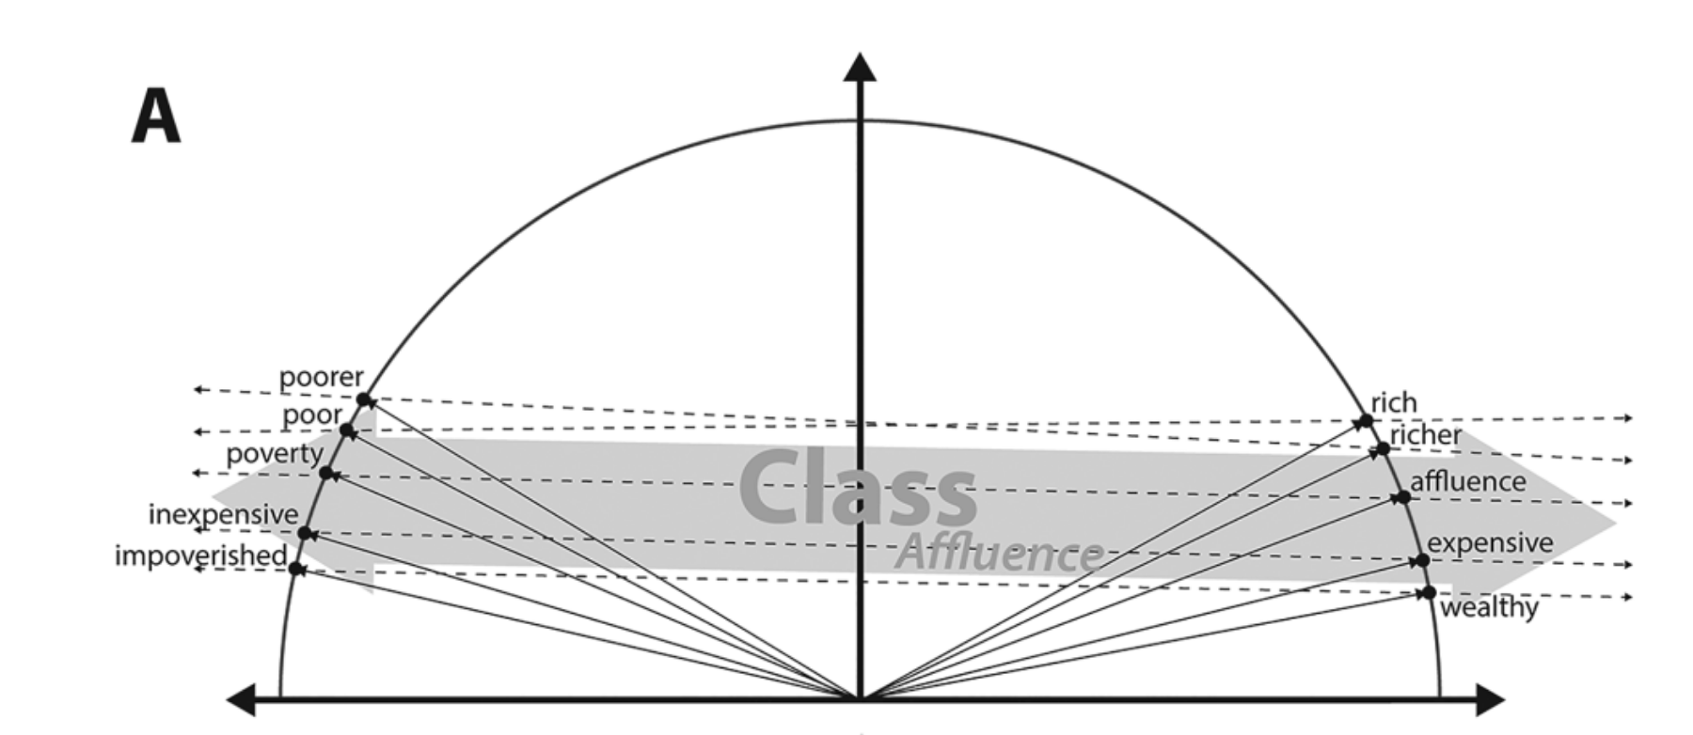
Cultural cartography Concept Class Analysis

Slide 6
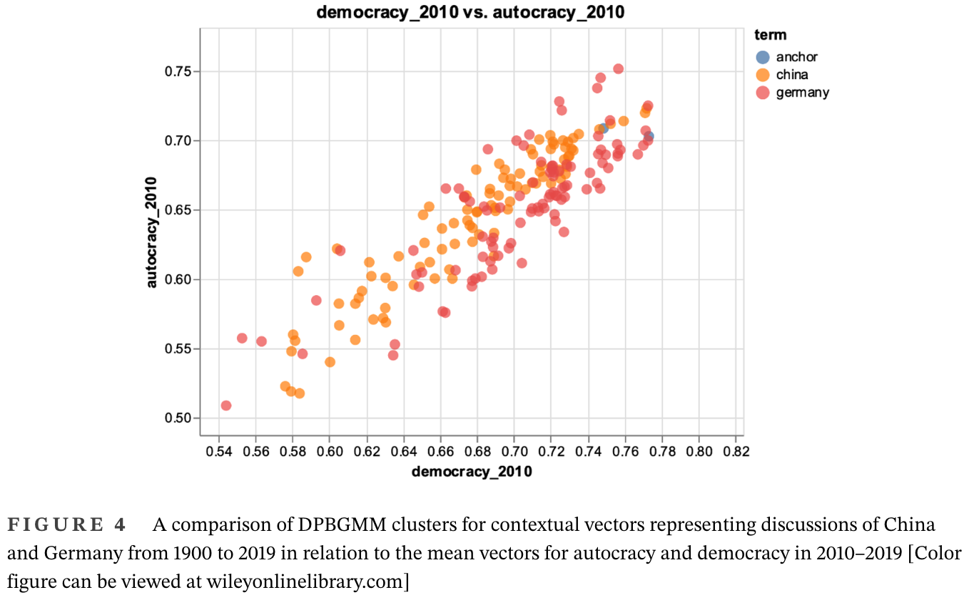
Cultural cartography Dirichlet Process Bayesian Gaussian Mixture Models (!!)

Slide 7
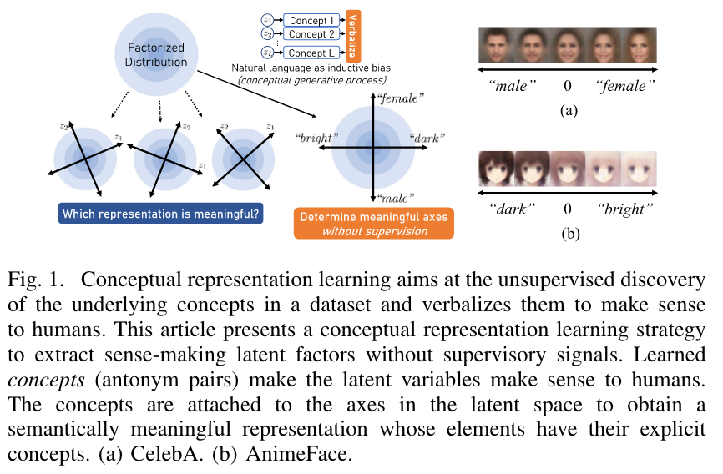
A future method? Disentanglement (aka “Variational autoencoders”)

Slide 8
Complexity and Simplification
So …
How much complexity do we need? How much can we manage?
How much simplification do we require? How much can we accept?
My hypothesis (aka “working guess”) is that our images of the child need about a dozen dimensions
The methodological goal is to see what the data suggest

Slide 9
THANK YOU!
QUESTIONS?
chris.borst@mail.mcgill.ca

